Slide 1
Dashboard Overview December 2021

Slide 2





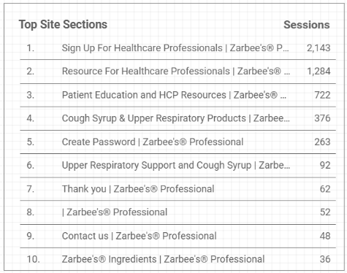
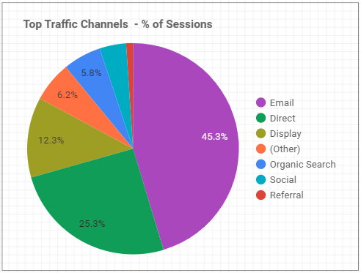
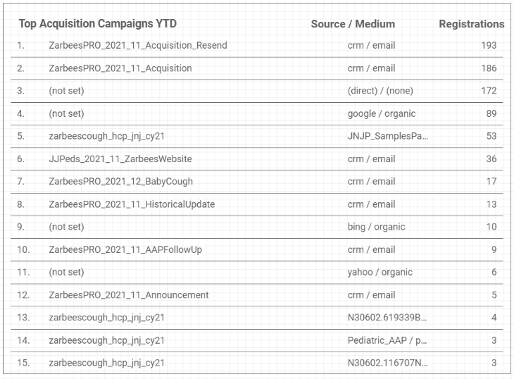
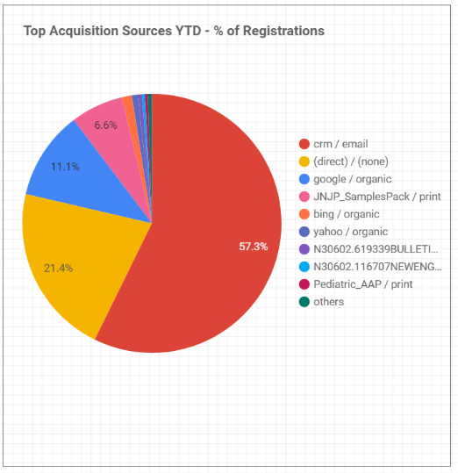
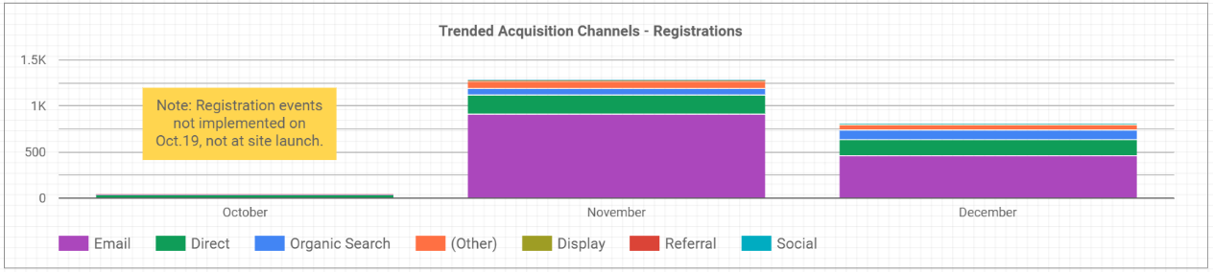
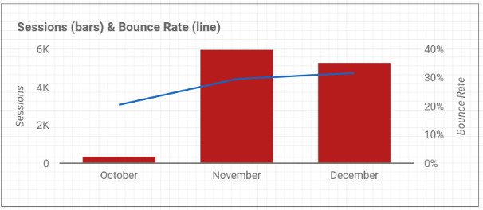
Zarbee's Professional
Notes:
Info at the top: The graph on the bottom right shows in 2021, November had the highest session rate with 5,980 sessions in total.
The top 3 site sections for December 2021:
- Sign up Page (2,143 sessions)
- Resource for HCP's (1,284 Sessions)
- Patient Education and HCP Resources (722 Sessions)
The top 3 Traffic Channels for December 2021:
- Email 2,414 (45.3%)
- Direct 1,345 (25.3%)
- Display 654 (12.3%)
The top 3 Acquisition Campaigns – Registrations
- ZarbeesPro 2021 11 Acquisition Resend – crm/ email - 193 registrations
- ZarbeesPro 2021 11 Acquisition – crm/ email – 186 registrations
In December For top Acquisition Sources – Registrations
- 461 HCP's registered through email (which was 57.3%), 172 registered directly (which was 21.4%), 105 through organic search's (google/organic was 11.1%).
- The month with the most registrations for Trended Acquisition Channels in 2021, was November with email being the most used source.

Slide 3







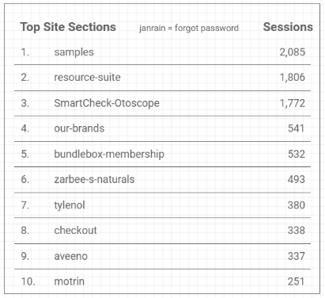
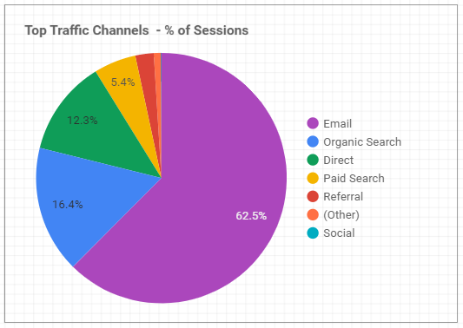
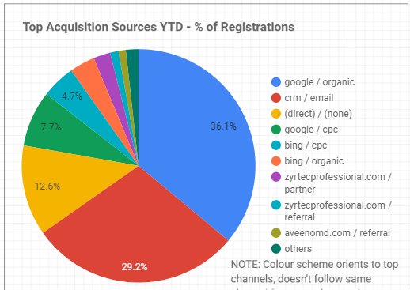
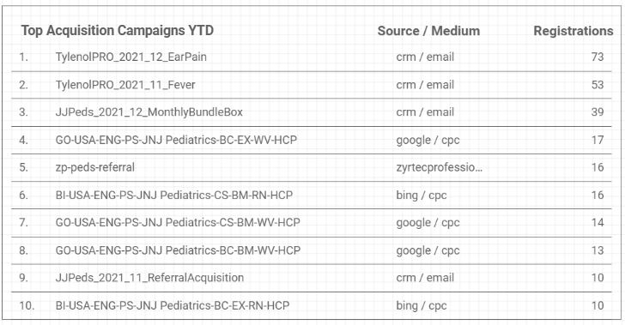
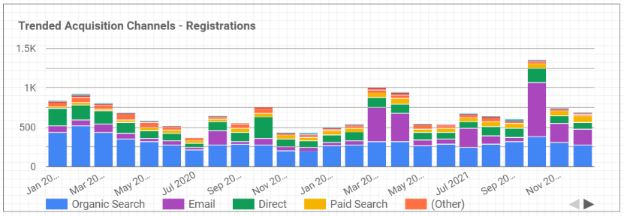
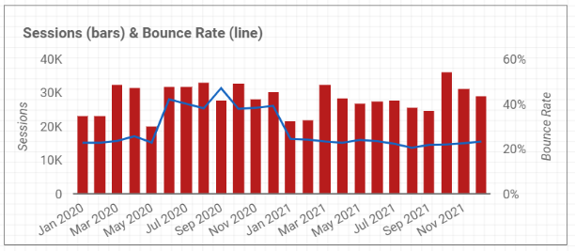
JNJ Pediatrics
Notes:
Info at the top: The graph on the bottom left shows in 2021, October had the highest session rate with 36,300 sessions in total.
The top 3 site sections for December 2021:
- Samples (2,085 sessions)
- Resource-suite (1,806 Sessions)
- SmartCheck-Otoscope (1,772 Sessions)
The top 3 Traffic Channels for December 2021:
- Email 18,261 (62.5%)
- Organic 4,797 (16.4%)
- Direct 3,599 (12.3%)
In December For top Acquisition Sources – Registrations
- 247 HCP's registered through google/ organic search (which was 36.1%), 200 registered through email (which was 29.2%), 86 through direct search (which was 12.6%).
- The month with the most registrations in 2021 for Trended Acquisition Channels in 2021, was October with email being the most used source.
The top 3 Acquisition Campaigns – Registrations
- TylenolPRO 2201 12 EarPain – crm/ email - 73 registrations
- TylenolPRO 2201 11 Fever – crm/ email - 53 registrations
- TylenolPRO 2201 12 MonthlyBundleBox – 39 registrations

Slide 4







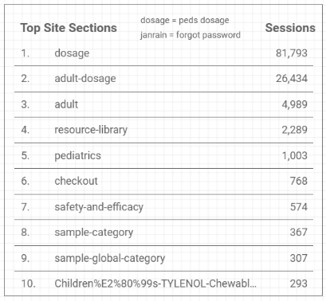
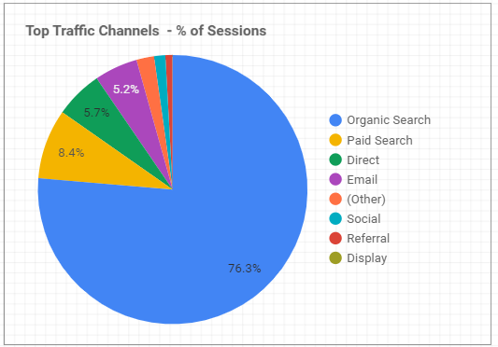
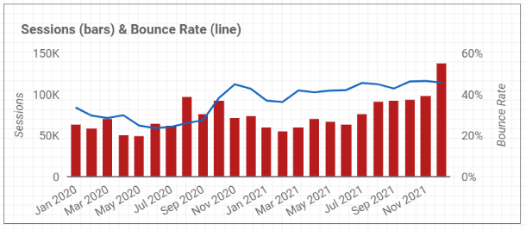
Tylenol Professional
Notes:
Info at the top: The graph on the right shows in 2021, December had the highest session rate with 138,205 sessions in total.
The top 3 site sections for December 2021:
- Dosage (81,793 sessions)
- Adult-Dosage (26,434 Sessions)
- Adult (4,989 Sessions)
The top 3 Traffic Channels for December 2021:
- Organic Search 105,498 (76.3%)
- Paid Search 11,609 (8.4%)
- Direct 7,921 (5.7%)

Slide 5
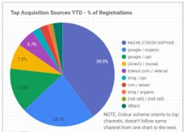
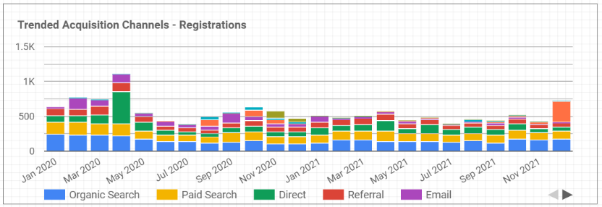
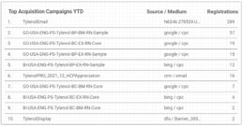
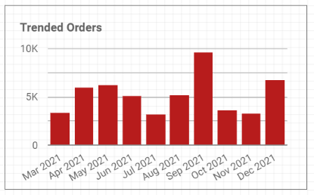
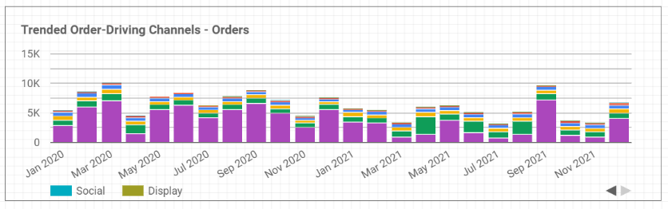
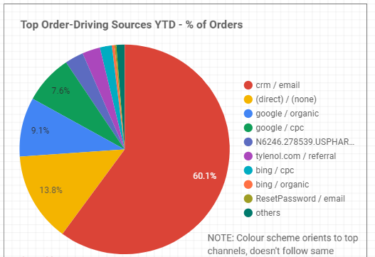
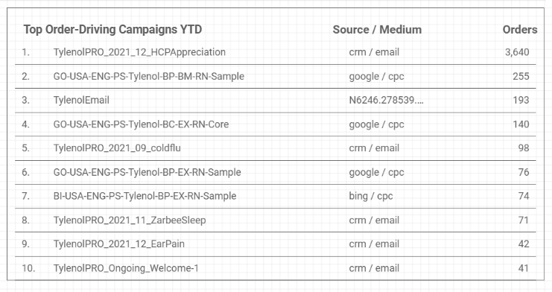
Tylenol Professional
Notes:
In December For top Acquisition Sources – Registrations
- 289 HCP's registered through a banner (which was 39.9%), 167 registered through google/organic Search (which was 23.1%), 100 through google cpc (which was 13.8%).
- The month with the most registrations for Trended Acquisition Channels in 2021 was December with other being the most used source.
The top 3 Acquisition Campaigns – Registrations
- Tylenol Email – Banner - 289 registrations
- GO USA ENG PS Tylenol BP BM RN Sample – google/cpc - 57 registrations
- Go USA ENG PS Tylenol BC EX RN Core- google/cpc – 19 registrations

Slide 6





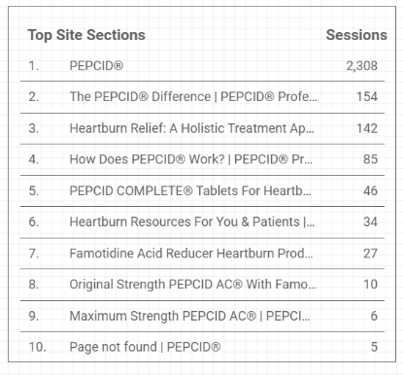
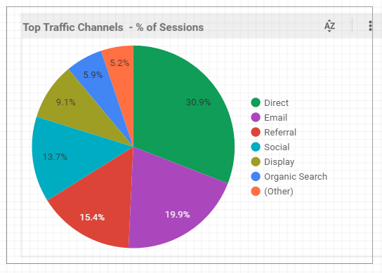
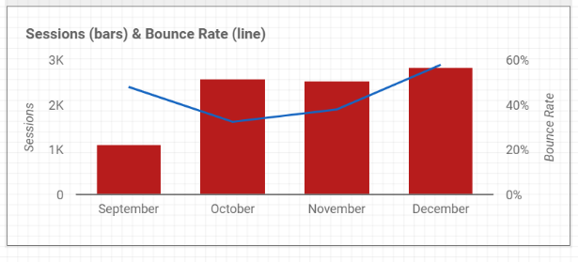
Pepcid Professional
Notes:
Info at the top: The graph on the right shows in 2021, December had the highest session rate with 2,827 sessions in total.
The top 3 site sections for December 2021:
- Pepcid (2,308 sessions)
- The PEPCID® Difference | PEPCID® Professional (154 Sessions)
- Heartburn Relief: A Holistic Treatment Approach (142 Sessions)
The top 3 Traffic Channels for December 2021:
- Direct 873 (30.9%)
- Email 562 (19.9%)
- Referral 434 (15.4%)

Slide 7
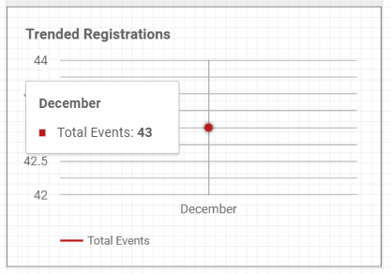
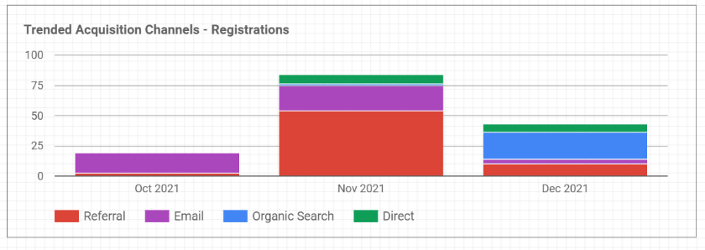
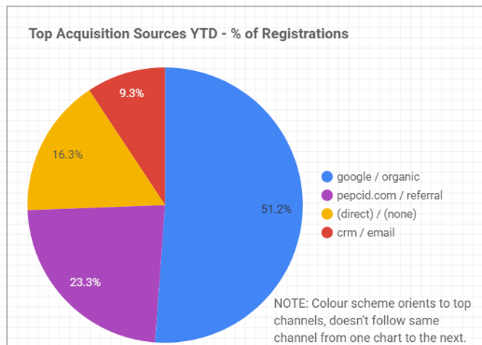
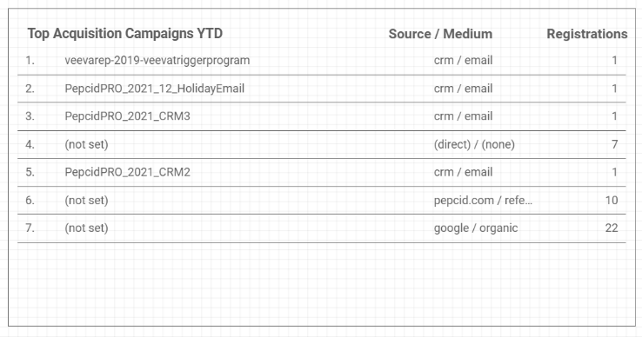
Pepcid Professional
Notes:
- The month with the most registrations for Trended Acquisition Channels in 2021 was November with referral being the highest source.
In December For top Acquisition Sources – Registrations
- 22 HCP's registered through google/ organic search (which was 51.2%), 10 registered through pecid.com referral (which was 23.3%), 7 through direct search (which was 16.3%).
- The month with the most registrations for Trended Acquisition Channels in 2021 was November with referral being the most used source.
The top 3 Acquisition Campaigns – Registrations
- veeverap 2019 veevatriggerprogram – crm/email - 1 registrations
- PepcidPRO 2021 12 HolidayEmail – crm/email - 1 registrations
- PepcidPRO 2021 CRM3 - crm/email – 1 registrations

Slide 8



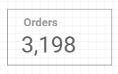
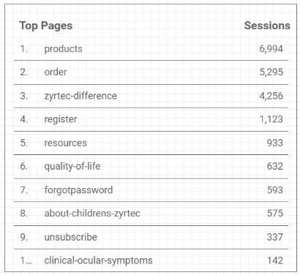
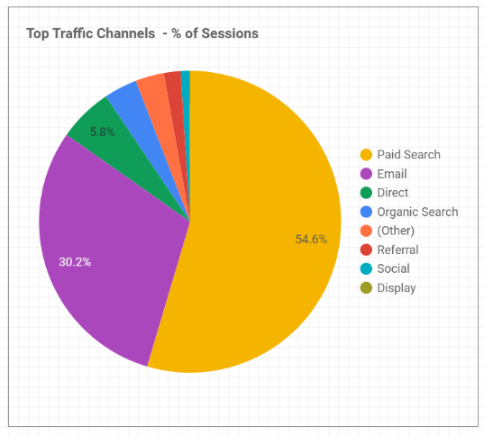
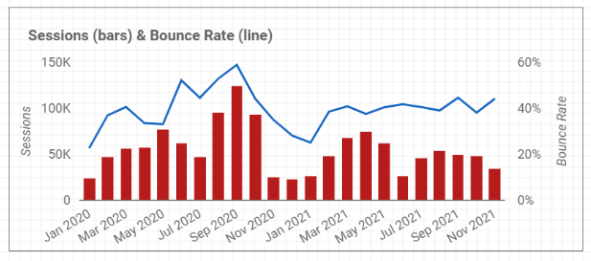
Zyrtec Professional
Notes:
Info at the top: The graph on the right shows in 2021, April had the highest session rate with 74,764 sessions in total.
The top 3 site sections for December 2021:
- Products (6,994 sessions)
- Order (5,295 Sessions)
- Zyrtec-Difference (4,256 Sessions)
The top 3 Traffic Channels for December 2021:
- Paid Search 16,006 (54.6%)
- Email 8,851 (30.2%)
- Direct 1,705 (5.8%)

Slide 9
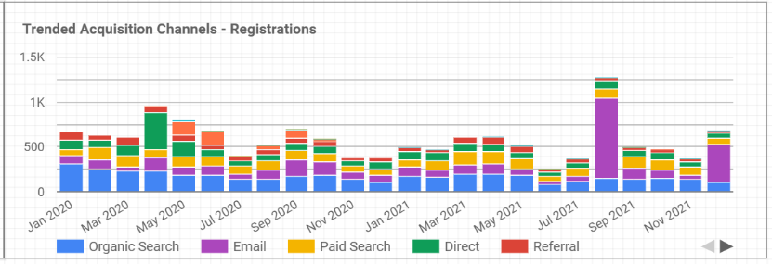
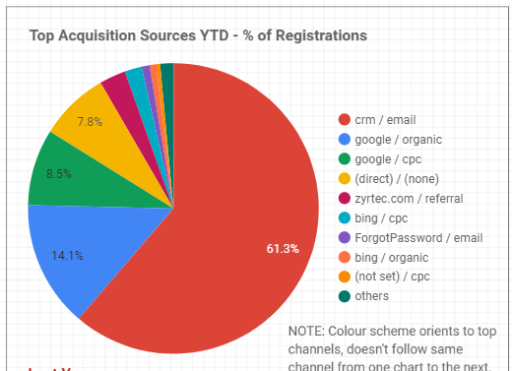
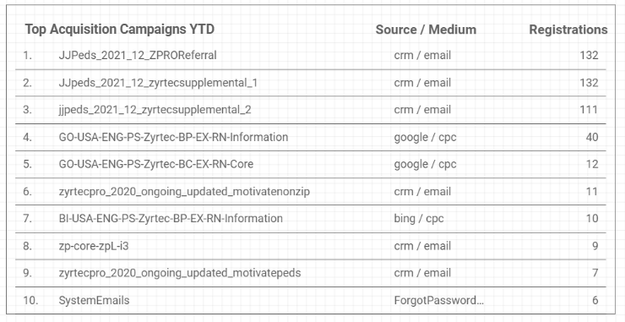
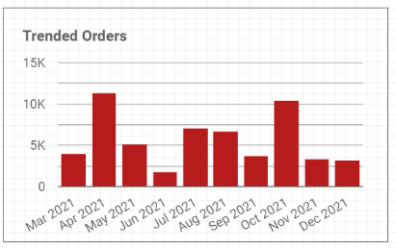
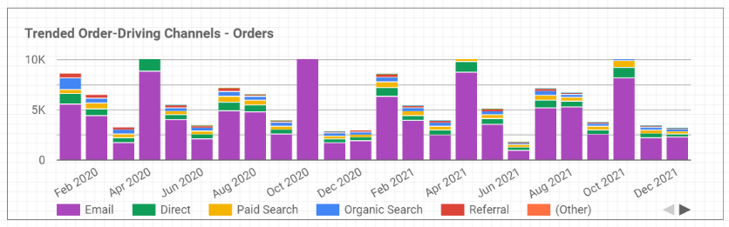
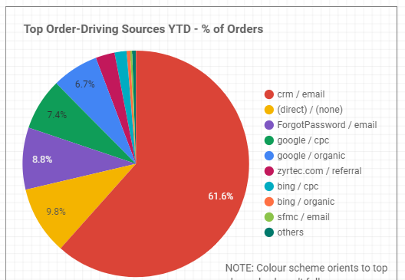
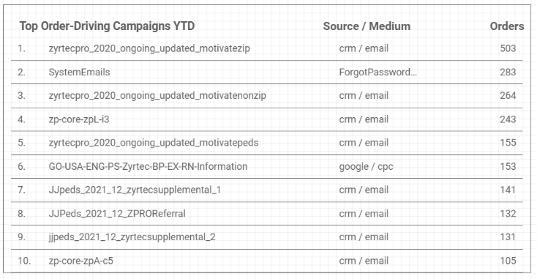
Zyrtec Professional
Notes:
- The month with the most registrations for Trended Acquisition Channels in 2021 was November with referral being the most used source.
In December For top Acquisition Sources – Registrations
- 418 HCP's registered through crm/email (which was 61.3%), 96 registered through google organic (which was 14.1%), 58 through google/cpc (which was 8.5%).
The top 3 Acquisition Campaigns – Registrations
- JJPeds_2021_12_ZPROReferral – crm/email - 132 registrations
- JJpeds_2021_12_zyrtecsupplemental_132 – crm/email - 1 registrations
- jjpeds_2021_12_zyrtecsupplemental_2 - crm/email – 111 registrations

Slide 10







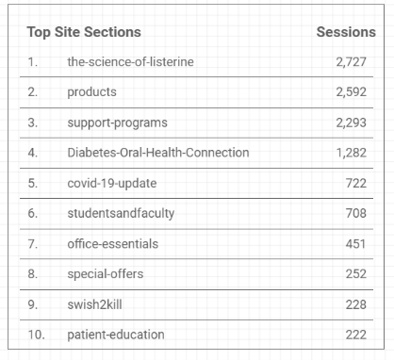
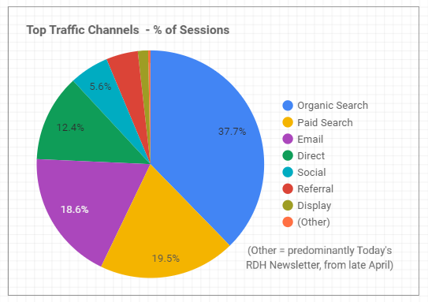
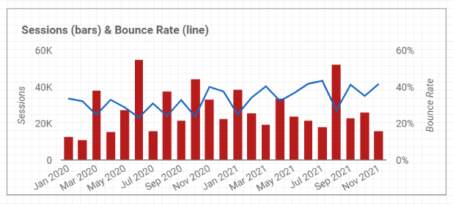
Listerine Professional
Notes:
Info at the top: The graph on the right shows in 2021, August had the highest session rate with 52,496 sessions in total.
The top 3 site sections for December 2021:
- organic Search 15,884 (37.7%)
- Paid search 8,198 (19.5%)
- email 7,826 (18.6%)
The top 3 Traffic Channels for December 2021:
- the-science-of-listerine (2,727 sessions)
- products (2,592 Sessions)
- support-programs (2,293 Sessions)

Slide 11
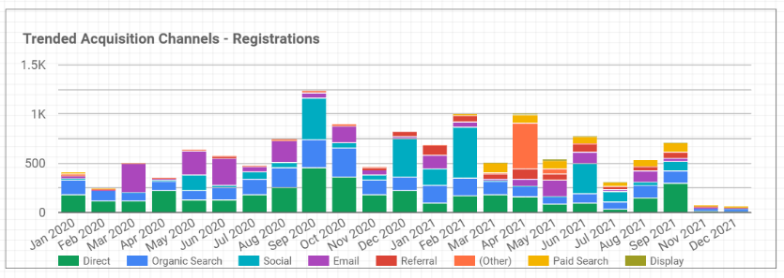
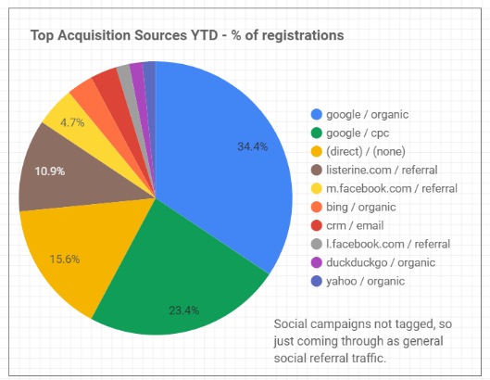
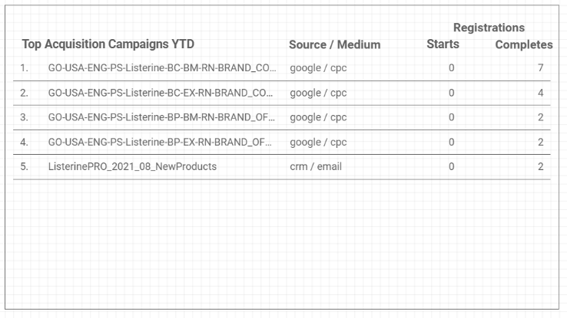
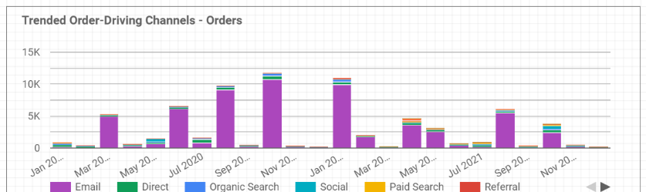
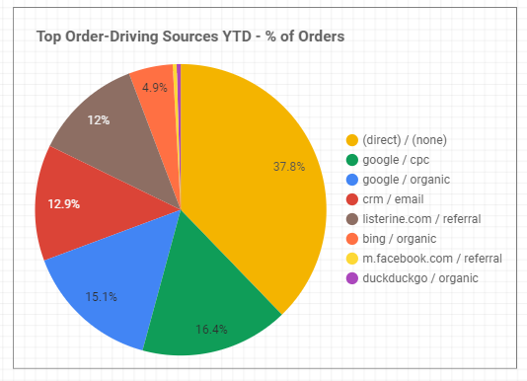
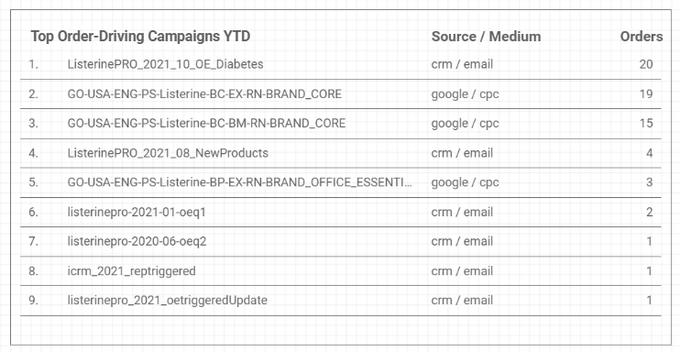
Listerine Professional
Notes:
- The months with the most registrations for Trended Acquisition Channels in 2021 was Febraury and April with social being the most used source for February and other for April.
In December For top Acquisition Sources – Registrations
- 22 HCP's registered through google organic search (which was 34.4%), 15 registered through google/cpc (which was 23.4%), 10 direct/ none (which was 15.6%).
The top 3 Acquisition Campaigns – Registrations
- GO-USA-ENG-PS-Listerine-BC-BM-RN-BRAND_CORE – google/cpc - 7 registrations
- GO-USA-ENG-PS-Listerine-BC-EX-RN-BRAND_CORE – google/cpc - 4 registrations
- GO-USA-ENG-PS-Listerine-BP-BM-RN-BRAND_OF - google/cpc – 2 registrations

